Slide 1
Ridge and Lasso regression Algorithm

Slide 2
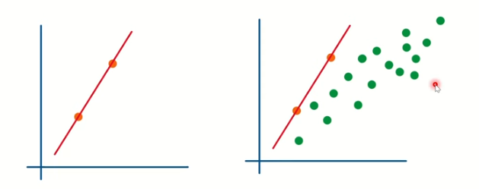
Ridge Regression
Ridge regression is a technique to prevent overfitting
Overfitting - model that work 100% perfect with train data, but have more error in test data ie high variance

Slide 3

To prevent this draw a ridge regression line instead of linear regression line
By adding penalty to the residual square loss, slope of the linear regression line will be reduced
Penalty term
Can be any positive value

Slide 4
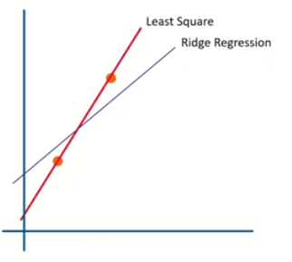
After adding Penalty term to the y=mx+c, ridge regression line can be drawn
Variance has been reduced and overfitting condition also reduced

Slide 5
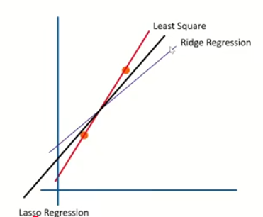
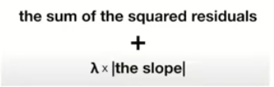
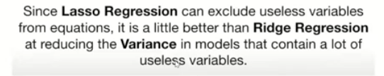
Lasso Regression
Lasso Regression is a linear regression technique that adds a penalty to the loss function to prevent overfitting.
This penalty is based on the absolute values of the coefficients.

Slide 6
Difference between Ridge and Lasso
Characteristic | Ridge Regression | Lasso Regression
Feature Selection | Does not perform feature selection. All predictors are retained | Performs automatic feature selection. Less important predictors are completely excluded
When to use | Best suited for situations where all predictors are potentially relevant | Ideal when you suspect that only a subset of predictors is important
Computation | Generally faster as it doesn’t involve feature selection | May be slower due to the feature selection process

Slide 7
Implementation
Ridge Regression
ridge = RidgeRegression(alpha=1.0)
ridge.fit(X, y)
Lasso Regression
model = LassoRegression(iterations=1000, learning_rate=0.01, l1_penalty=500)
model.fit(X_train, Y_train)

